Slide 1
National Data Opt-out Programme
Northern, Yorkshire and Humberside NHS Directors of Informatics Forum
Friday 12 January 2018

Slide 2
The national data opt-out
Geof Welford-Dart, Local Implementation Manager, North Region

Slide 3
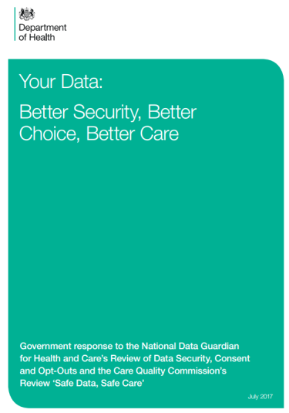
NDG Review and Government’s response
National Data Guardian Review – Key Points & Recommendations
You are protected by the law
Information is essential for high quality care
Information is essential for other beneficial purposes
You have the right to opt out of your personal confidential information being used for these other purposes beyond your direct care:
Providing local services and running the NHS and social care
Supporting research and improving treatment and care
This opt-out will be respected by all organisations that use health and care information
Explicit consent will continue
The opt-out will not apply to anonymised information
Arrangements will continue to cover exceptional circumstances
The Government response to the National Data Guardian Review supports the recommendations
Notes:
It has been recognised that public trust in the use of personal confidential data has been eroded in recent years and steps needed to be taken to demonstrate trustworthiness and ensure that the public can have confidence in the system. As a result in September 2015, the Secretary of State for Health asked the National Data Guardian, to work alongside the Care Quality Commission (CQC), and carry out an intensive Review to recommend: new data security standards, a method for testing compliance against these standards, and a new consent or opt-out model for data sharing in relation to patient confidential data
In July 2016, the National Data Guardian’s Office published an independent review on data security, consent and opt-outs, followed by a public consultation that ran until September 2016. The review recommended a new opt-out model to give patients clear choices about how their information could be shared, and also included a set of agreed data security standards to ensure that the NHS keeps personal and confidential information safe and secure, particularly in the face of an increasingly digital world
Page 6 of Review of Data Security, Consent and Opt-Outs
“1.32 The new model will not change the current system with regard to sharing for direct care. Relevant information about a patient should continue to be shared between health professionals in support of their care. An individual will still be able to ask their doctor or other healthcare professional not to share a particular piece of information with others involved in providing their care and should be asked for their explicit consent before access to their whole record is given. Similarly, health and social care integration has been driving local innovation in services which rely on (appropriate and legal) sharing of personal confidential data. Different parts of the country have already put arrangements in place to help people to understand how their data is being used to support care such as the Leeds Care Record, and the North West London Integrated Care Pioneer. In recognition of the value of these local innovations, the Review has sought to develop a solution that complements rather than conflicts with what is being achieved locally.“

Slide 4
Implementation Timetable
Area
Opt-out preparations
Opt-out service testing
Setting opt outs
Applying opt-outs
New Data Protection Legislation (GDPR)
Communications strategy
Previously
Jan – Mar 2018
Apr – Jun 2018
Jul 2018 – Mar 2019
Apr 2019 – 2020
Awareness raising
Readying organisations for implementation
Build opt-out service
Test opt-out service
25/05/18 Opt-outs can start being set from this date
25/05/18 Opt-outs upheld by NHS Digital
Upholding of opt-outs phased in for all other health and care organisations
25/05/18 New data protection legislation comes into effect
Develop strategy
Develop materials
Communication materials available
Notes:
Members of the public will be able to start setting national data opt-outs from March 2018 (as part of ‘private beta’ testing), but the public launch of the service will be 25th May 2018, to align with new data protection legislation (GDPR).
Patients who had previously registered a ‘Type 2’ opt-out will be notified that this will be migrated to a National Data Opt-out, in line with the public launch in May 2018.
Members of the public will be able to start setting national data opt-outs from 25 May 2018.
The Department of Health will work with NHS England and NHS Digital to support all health and social care organisations to uphold the national data opt-out by 2020.
The national data opt-out will be referenced within communications on data use and sharing rather than the communications being focused on the national data opt-out alone.
A separate piece of work has been commissioned to develop a wider benefits of data sharing communications strategy.

Slide 5
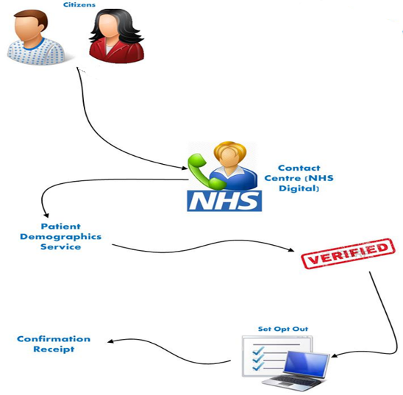
Solution approach
1) Setting preference(s) …
2) Storing preference(s) …
Patient-facing digital front-end
Spine repository
Non digital front-end
Opt out look-up service
GP
National Bodies
National data disseminations
Local data disseminations
3) Upholding preference(s) …
Notes:
Setting preference(s)
Solutions will be made available to enable people who want to opt-out to do so, both digitally (online) and non-digitally through a national contact centre (telephone, email or letter) to process their request
Objectives:
To enable patients to easily record their opt-out preference
To record that preference once and for that to be available to all health and care organisations to enable the preference to be applied
Improve transparency on how data are used and the benefits to inform the patients decision before they set their preference
Accessibility
Will ensure that the service and systems can be used by the diverse set of users who will interact with them.
User testing will involve users with a range of impairments to obtain feedback as the service and systems are developed
2. Storing Preferences
The national data opt-out preference will be held in a single place on the Spine and organisations are not expected to create or hold local lists of those patients that have set an opt-out preference
3. Upholding preferences
The technical solutions for organisations to be able access the opt-out preference and match this to their own data before the data is to be shared are being assessed. It is intended that solutions will ensure ease of access to the Spine repository

Slide 6
Policy Position

Slide 7
Applying the national data opt-out
Applies to data shared
for planning and research purposes
Data shared for an individuals care & treatment
Legal requirement / public interest / consent
Data is anonymised
Is 1 option that covers: Research – finding ways to improve treatments and identify causes of and cures for illnesses
Planning – to improve and enable the efficient and safe provision of health and care services
E.g. where data is shared between the health and care professionals in a hospital and in a GP practice
E.g. There is a mandatory legal requirement such as a court order, to protect the greater interests of the general public or there is explicit consent
The data shared is determined to be compliant with the ICO Anonymisation: managing data protection risk code of practice
This identifies you personally
This identifies you personally
This identifies you personally
This does not identify you personally
Notes:
There is just one choice and the opt-out is for both data used for research and for planning purposes
The national data opt-out applies only where personally identifiable data are being shared for purposes beyond an individuals care and treatment and is intended to be used in research studies or to help in managing the efficient and safe running of the health and care system
Regardless of the national data opt-out personal identifiable data cannot be used for insurance or marketing purposes without the explicit consent of the patient
The national data opt-out is for purposes beyond an individuals care and treatment not their individual care aka direct care
The national data opt-out will not apply where:
1. There is a mandatory legal requirement such as:
CQC has statutory powers to require information for their inspection purposes
Reporting of notifiable diseases
Reporting of gunshot wounds
NHS Digital require a health and care organisation to provide data under s259 of HSCA 2012
Type 2 opt-out transition – Patients who had previously registered a ‘Type 2’ opt-out will be migrated to a national data opt-out.

Slide 8
When it applies
The national data opt-out will apply when:
personally identifiable data is used for purposes beyond an individual’s care and treatment
the legal bases to use the data is based on approvals made under:
regulation 2 (medical purposes related to the diagnosis or treatment of neoplasia i.e. cancer); or
regulation 5 (general medical purposes including medical research)
of the Control of Patient Information Regulations 2002 under the NHS Act 2006 s251
The Confidentiality Advisory Group which provides independent expert advice on applications for data use under s251 can in some cases agree that opt-outs do not apply but have indicated that this would only be in exceptional circumstances
8
Notes:
NATIONAL HEALTH SERVICE, ENGLAND AND WALES - The Health Service (Control of Patient Information) Regulations 2002
Reg 2 - Medical purposes related to the diagnosis or treatment of neoplasia
(1) Subject to paragraphs (2) to (3) and regulation 7, confidential patient information relating to patients referred for the diagnosis or treatment of neoplasia may be processed for medical purposes approved by the Secretary of State.
(2) For the purposes of this regulation, “processing” includes (in addition to the use, disclosure or obtaining of information) any operations, or set of operations, which are undertaken in order to establish or maintain databases for the purposes set out in paragraph (1 )
(3) The processing of confidential patient information for the purposes specified in paragraph (1) may be undertaken by bodies or persons who (either individually or as members of a class) are (a)approved by the Secretary of State, and (b)authorized by the person who lawfully holds the information.
Reg 5 - General
Subject to regulation 7, confidential patient information may be processed for medical purposes in the circumstances set out in the Schedule to these Regulations provided that the processing has been approved— (a) in the case of medical research, by both the Secretary of State and a research ethics committee, and (b) in any other case, by the Secretary of State.
Reg 7 - Restrictions and exclusions
Where a person is in possession of confidential patient information under these Regulations, he shall not process that information more than is necessary to achieve the purposes for which he is permitted to process that information under these Regulations

Slide 9
When it does not apply
The national data opt-out will not apply when:
personally identifiable data is used for the patients individual care and treatment
the patient has given explicit consent for the use of their data for the purpose being considered this includes where the consent may have been given prior to the patient registering a national data opt-out
data is being provided under a mandatory legal requirement that means a data controller must provide the data (such as where there is a court order or the Care Quality Commission have used their statutory powers to require information for inspection purposes)
there is an overriding public interest (such as to support the investigation of serious crime and/or to prevent abuse or serious harm to others and this includes approvals made under regulation 3 of the Control of Patient Information Regulations 2002 i.e. communicable diseases and other public health risks)
data is provided in an anonymised form such that it meets the Anonymisation: managing data protection risk code of practice – issued by the Information Commissioner’s Office
9
Notes:
NATIONAL HEALTH SERVICE, ENGLAND AND WALES
The Health Service (Control of Patient Information) Regulations 2002
Reg 3 Communicable disease and other risks to public health
(1) Subject to paragraphs (2) and (3) and regulation 7, confidential patient information may be processed with a view to—
(a) diagnosing communicable diseases and other risks to public health;
(b) recognising trends in such diseases and risks;
(c) controlling and preventing the spread of such diseases and risks;
(d) monitoring and managing—
(i) outbreaks of communicable disease;
(ii) incidents of exposure to communicable disease;
(iii) the delivery, efficacy and safety of immunisation programmes;
(iv) adverse reactions to vaccines and medicines;
(v) risks of infection acquired from food or the environment (including water supplies);
(vi) the giving of information to persons about the diagnosis of communicable disease and risks of acquiring such disease.
(2) For the purposes of this regulation, “processing” includes any operations, or set of operations set out in regulation 2(2) which are undertaken for the purposes set out in paragraph (1).
(3) The processing of confidential patient information for the purposes specified in paragraph (1) may be undertaken by—
(a) the Public Health Laboratory Service;
(b) persons employed or engaged for the purposes of the health service;
(c) other persons employed or engaged by a Government Department or other public authority in communicable disease surveillance.
(4) Where the Secretary of State considers that it is necessary to process patient information for a purpose specified in paragraph (1), he may give notice to any body or person specified in paragraph (3) to require that body or person to process that information for that purpose and any such notice may require that the information is processed forthwith or within such period as is specified in the notice.
(5) Where confidential information is processed under this regulation, the bodies and persons specified in paragraph (3) shall make available to the Secretary of State such information as he may require to assist him in the investigation and audit of that processing and in his annual consideration of the provisions of these Regulations which is required by section 60(4) of the Act.

Slide 10
When it does not apply
The national data opt-out will not apply when:
data is to be provided for the National Cancer Registration Service
Data is to be provided for the National Congenital Anomalies & Rare Diseases Register
data is provided for the oversight and provision of population screening programmes
patient registration information is shared with the Office for National Statistics for the production of official statistics
these both have their own separate opt-out mechanism
10
Notes:
NATIONAL HEALTH SERVICE, ENGLAND AND WALES
The Health Service (Control of Patient Information) Regulations 2002
Reg 3 Communicable disease and other risks to public health
(1) Subject to paragraphs (2) and (3) and regulation 7, confidential patient information may be processed with a view to—
(a) diagnosing communicable diseases and other risks to public health;
(b) recognising trends in such diseases and risks;
(c) controlling and preventing the spread of such diseases and risks;
(d) monitoring and managing—
(i) outbreaks of communicable disease;
(ii) incidents of exposure to communicable disease;
(iii) the delivery, efficacy and safety of immunisation programmes;
(iv) adverse reactions to vaccines and medicines;
(v) risks of infection acquired from food or the environment (including water supplies);
(vi) the giving of information to persons about the diagnosis of communicable disease and risks of acquiring such disease.
(2) For the purposes of this regulation, “processing” includes any operations, or set of operations set out in regulation 2(2) which are undertaken for the purposes set out in paragraph (1).
(3) The processing of confidential patient information for the purposes specified in paragraph (1) may be undertaken by—
(a) the Public Health Laboratory Service;
(b) persons employed or engaged for the purposes of the health service;
(c) other persons employed or engaged by a Government Department or other public authority in communicable disease surveillance.
(4) Where the Secretary of State considers that it is necessary to process patient information for a purpose specified in paragraph (1), he may give notice to any body or person specified in paragraph (3) to require that body or person to process that information for that purpose and any such notice may require that the information is processed forthwith or within such period as is specified in the notice.
(5) Where confidential information is processed under this regulation, the bodies and persons specified in paragraph (3) shall make available to the Secretary of State such information as he may require to assist him in the investigation and audit of that processing and in his annual consideration of the provisions of these Regulations which is required by section 60(4) of the Act.

Slide 11
More detailed information will be provided on:
Formal proxies who are able to register a national data opt-out on someone else’s behalf such as people with powers of attorney and those representing patients who lack capacity
The maximum period of time that is permissible for a national data opt-out to be applied after it has been set by a patient
How the national data opt-out will apply where the data being used is not held in an electronic format such as in paper records and microfiche
What is classed as personally identifiable data
The point at which data being used for purposes beyond individual care and treatment needs to be considered for the national data opt-out
The scope and definition of individual care
The list of mandatory legal requirements
How the national data opt-out will apply to data used to support payment processing such as invoice validation
Notes:
Also still in development:
How a national data opt-out should apply where a patient record contains details of another patient such as a record holding both a mother and child's details
Whether there may be review points when a patient is prompted to consider their current national data opt-out choice, recognising that a patient can change their national data opt-out setting at any time
The minimum age at which a patient will be able to set a national data opt-out
The rules and procedures for a parent, guardian or those with legal responsibilities for children to be able to set a national data opt-out on their behalf
the application of the national data opt-out to surveys
the application of the national data opt-out to risk stratification
any other specific exemptions

Slide 12
Fit with General Data Protection Regulations
The national data opt-out will sit alongside the new General Data Protection Regulations /Data Protection Bill 2017 and is not replaced or changed by it
Areas of overlap relate mainly to:
Understanding of consent
The GDPR ‘right to object’
Potential changes to ICO Code of Practice on Anonymisation
Privacy Notices

Slide 13
GDPR and confidentiality
GDPR requires that processing of personal data is fair, lawful and transparent
To be lawful in the UK the common law duty of confidence (confidentiality) must also be satisfied
This means under the GDPR that for health and care data:
an Article 6 condition needs to be satisfied (for personal data); and
an Article 9 condition needs to be satisfied (as health data is a special category of data) and
To respect confidentiality
there is consent from a patient for the use of their data under common law or there is another legal basis which enables the common law duty to be set aside (i.e. there is a mandatory legal requirement or Sec 251 support, or overriding public interest)

Slide 14
Organisational Readiness
Trevor Anders Local Implementation Programme Manager

Slide 15
Implemented in two stages
Stage 1 - Readying for setting opt-outs
Previously undertaken general awareness work with health and care organisations
Implemented a private on-line solution for recording opt-outs in September 2017, now testing both the digital and non digital solutions, processes and supporting materials for the setting of a national data opt-out
Engagement focus now is on preparing health and care organisations to be ready for the introduction of the national data opt-out and being able to handle queries from patients
Stage 2 – Upholding
Providing information on how and when to uphold the national data opt-out
The requirement for organisations to uphold the national data opt-out will be phased in through to 2020, starting with NHS Digital in May 2018
Notes:
Stage 1 is about raising awareness of the national data opt-out and how opt-out preferences can be set and changed.
The National Data Opt-out Programme are engaging as widely as possible with some circa 57000 organisations across the health and care system.
Engagement from January 2018 will be to ready the health and care service to enable conversations between patients and health and care professional about national data opt-outs, data sharing and the ways in which patients can set and change their opt-out preferences along with signposting to where more resources and materials will be available.

Slide 16
Materials to support the national data opt-out
Information materials will be made available with the expectation they can be adapted and tailored to suit local needs and be available through local channels as well as being hosted and available through national websites
The national data opt-out will be communicated as part of communicating about data use and sharing in the health and care system to provide greater transparency and understanding
A wider benefits of data sharing campaign strategy is being developed and delivery will take place outside of the National Data Opt-out Programme
Notes:
Will concentrate on developing content that can be used in a range of materials and this will be focused on the national data opt-out
3 layers of content will be made available:
Level 1 simple easy read information – these will be made available
Level 2 more detailed explanations and answers to more complex questions for those that want fuller understanding – these materials will be hosted and available from a national website but could be taken and made available through local channels as well
Level 3 technical guidance and answers to very specific questions – these materials will be hosted and available from a national website
These products and materials will communicate the opt-out and help raise awareness across the health and care system and help patients and the workforce to understand:
How an opt-out can be recorded
When an opt-out will be applied
How an opt-out can be applied
The intent is to provide information on data sharing and benefits rather than promote the national data opt-out though ensuring it is clearly referenced through these materials and for those that want to know more they are able to easily identify and access where more information is held
The National Data Opt-out Programme are also looking at what can be done in parallel to support messaging and approaches to communicating on General Data Protection Regulations
We expect communication materials to point out to other key supporting resources such as “Understanding Patient Data” which has case studies on data sharing and information on “Supporting Conversations” with patients and is supported by the Wellcome Trust
The Royal College of General Practitioners are also being commissioned to develop supporting implementation materials

Slide 17
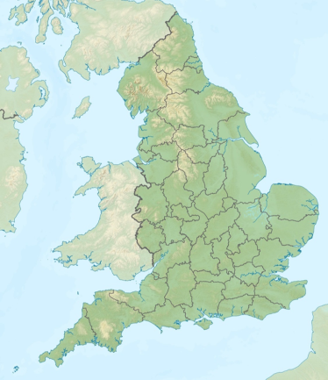
Organisation readiness - Stage 1
The national data opt-out will be launched to the public in May 2018
At this time and possibly earlier, patients/service users may start to ask questions about the national data opt-out and the uses of their data e.g. why do you share my data? what is the national data opt-out?, do I need to do anything?, have I already got an opt-out recorded?, what do I need to do to record a national data opt-out?
Organisations need to be prepared for handling these enquiries from patients/service users about the national data opt-out and considering how such questions will be managed within their organisation

Slide 18
Stage 1 - Checklist for public awareness
Responsible person identified to ready organisation for implementing national data opt-out awareness
Communications provided to all members of staff that need to be made aware of the national data opt-out
Privacy Notice materials on website have been assessed and updated
Other existing materials e.g. posters, registration forms have been checked for accuracy and updated to reflect the national data opt-out
Approach agreed on how, where and when to publicise information about data use and the national data opt-out perhaps aligned to transparency work for compliance with new data protection legislation (GDPR)
Handling plan for dealing with patient/service user enquiries has been agreed and communicated to staff
Notes:
Determine who will have responsibility for ensuring the organisation is ready for handling enquiries about national data opt-outs
Determine which members of staff need to be made aware of the national data opt-out i.e. are there members of staff that do not come into contact with patients/service users that will require no or limited information about the national data opt-out?
Look at the materials/content provided by the programme and determine which content is going to be used and how its going to be used e.g. to be included in any Privacy Notice on the website and/or provided as a fact sheet that can be printed off for patients on request
Review existing materials e.g. posters, leaflets, website content, registration forms to check any processing of data are adequately described, any reference to existing opt-outs are still correct and what needs to be updated to mention the national data opt-out
Decide how, where and when information about data use and the national data opt-out will be publicised

Slide 19
More information
National Data Opt-out Programme web pages & to join our mailing list
https://digital.nhs.uk/national-data-opt-out
National data opt-out enquiries mailbox newoptoutenquiries@nhs.net
Understanding Patient Data - Wellcome Trust
https://understandingpatientdata.org.uk
Information Governance Alliance (IGA) information on GDPR:
https://digital.nhs.uk/information-governance-alliance/General-Data-Protection-Regulation-guidance

